Slide 1
TIM 155: Water and Energy Management
Professor Brent Haddad
Spring 2017

Slide 2
Why Study Water and Energy?
Water and energy both are vital to the economy, the environment, and life itself.
Patterns of water and energy use are a fingerprint of society, and of our impact on the environment. Dramatic differences exist.
Science & technology matters: water and energy resources and technologies shape cultures and economies
Policy and society matters: vastly different ways exist to use water and energy to achieve economic, industrial, and household goals.
We are in a unique era in the history of water and energy use & impact on society and on the planet.

Slide 3
What are Analytics?
Analytics are methods of extracting information from data.
“Analytics” is often used in business contexts or referring to computer analysis.
In TIM 155 we will draw analytical methods from engineering, science, and economics.
Careful analysis can help us understand and manage our energy and water resources to achieve more of our goals with fewer negative impacts.

Slide 4
Review the Syllabus…
Course web sites:
https://tim155-spring17-01.courses.soe.ucsc.edu/
…and hopefully the Canvas site for grading.

Slide 5
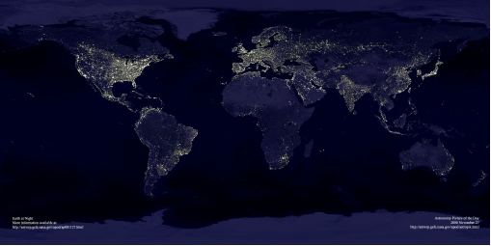
Where is energy consumption happening? Earth’s city lights
Data courtesy Marc Imhoff of NASA GSFC and Christopher Elvidge of NOAA NGDC. Image by Craig Mayhew and Robert Simmon, NASA GSFC.

Slide 6
http://www.fao.org/nr/water/aquastat/maps/index.stm
Notes:
Explain terms
Source: N. Nakicenovic et al. 1998, Global Energy Perspectives, Cambridge University Press. Fig. 5.1, p. 64
Exergy Flux [TW] (=10¹² W)
Exergy Accumulation [ZJ] (=10²¹ J)

Slide 7
Notes:
Explain terms
Source: N. Nakicenovic et al. 1998, Global Energy Perspectives, Cambridge University Press. Fig. 5.1, p. 64
Exergy Flux [TW] (=10¹² W)
Exergy Accumulation [ZJ] (=10²¹ J)

Slide 8
August 15, 2003: 8:15 PM
Links between Water and Energy
Some examples

Slide 9
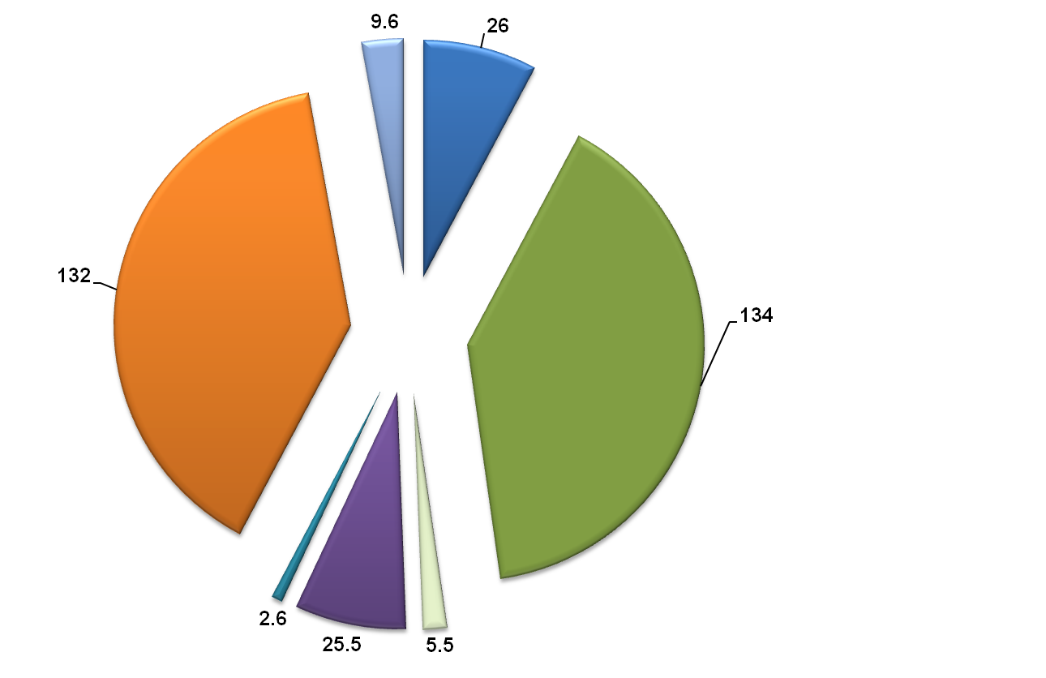
Withdrawal vs. Consumption:
An Important Distinction
Water is needed to produce energy
Commercial
Domestic
Withdrawal
(BGD)
1
7
Thermoelectric
Irrigation
3
107
1
4
3
Water Consumption (BGD)
Mining
Industrial
Livestock
Source: Jared Ciferno,NETL
Sources: ¹USGS, Estimated Use of Water in the United States in 2000, USGS Circular 1268, March 2004
²USGS, Estimated Use of Water in the United States in 1995, USGS Circular 1200, 1998
Notes:
Regardless of location, there is a general competition for water resources among various sectors of the economy. This slide compares water withdrawal and water consumption for various sectors of the economy. Key point is that for thermoelectric, water consumption is very small compared to thermoelectric withdrawal and irrigation consumption. This data is from the USGS reports.
Key up the irrigation consumption—future use of renewables/biofuels can increase this piece of the pie substantially. Need to focus R&D on efforts to promote efficient future power/fuels processes that have low water impact.
Fossil-based energy use and production will compete for limited water resources with other use sectors including agriculture, domestic, and industrial

Slide 10
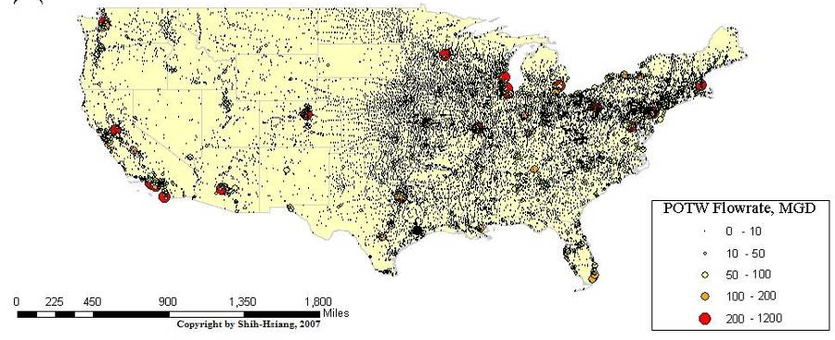
Water Consumption by cities in the U.S. (wastewater treatment plants)
Map by Shih-Tsiang; water flowing through wastewater
treatment facilities in US, 2007.

Slide 11
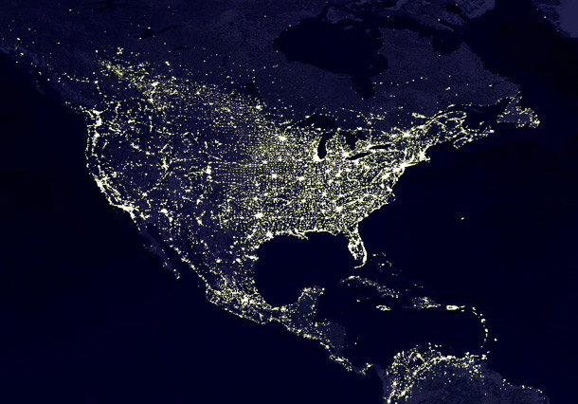
…Compare location of urban water and power consumption

Slide 12
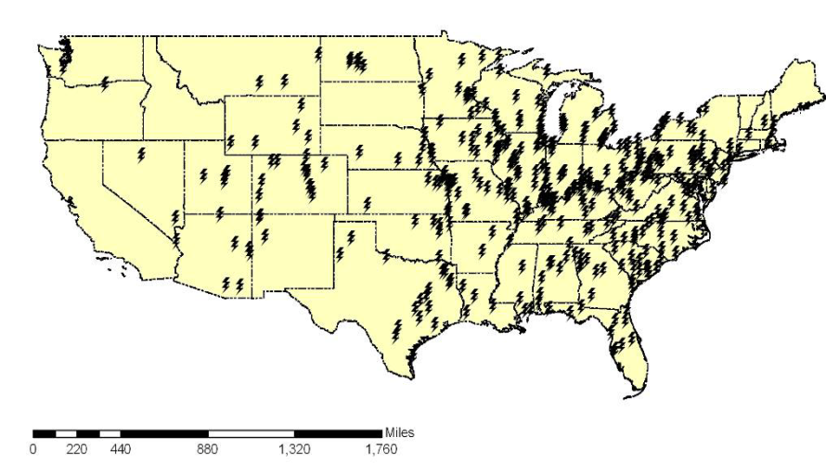
Pitt/Carnegie Mellon Study: water for 110 proposed new power plants
Findings
11.4 trillion gallons of municipal wastewater collected and treated annually in U.S.
On average, one fairly large POTW can completely satisfy the cooling water demand for each of 110 proposed power plants (EIA, 2007)
Inventory of available wastewater
Inventory of water needs
http://www.netl.doe.gov/technologies/coalpower/ewr/water/pp-mgmt/pubs/06550/42722FSRFG063009.pdf

Slide 13

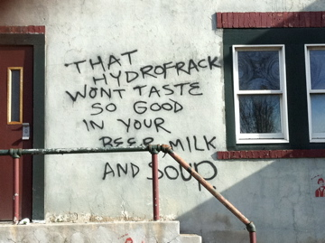
Hydrologic Fracturing, or “fracking”

Slide 14
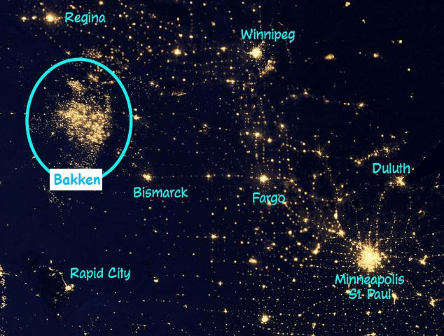

Slide 15
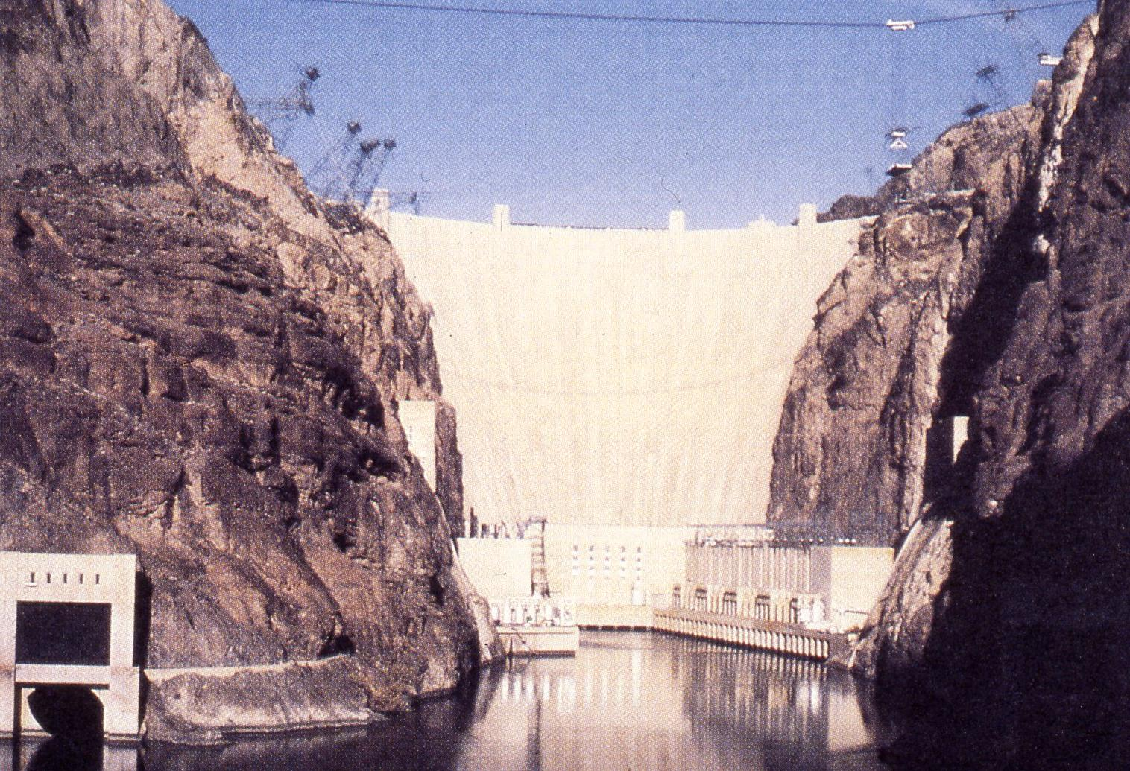
Hoover Dam, Colorado River

Slide 16
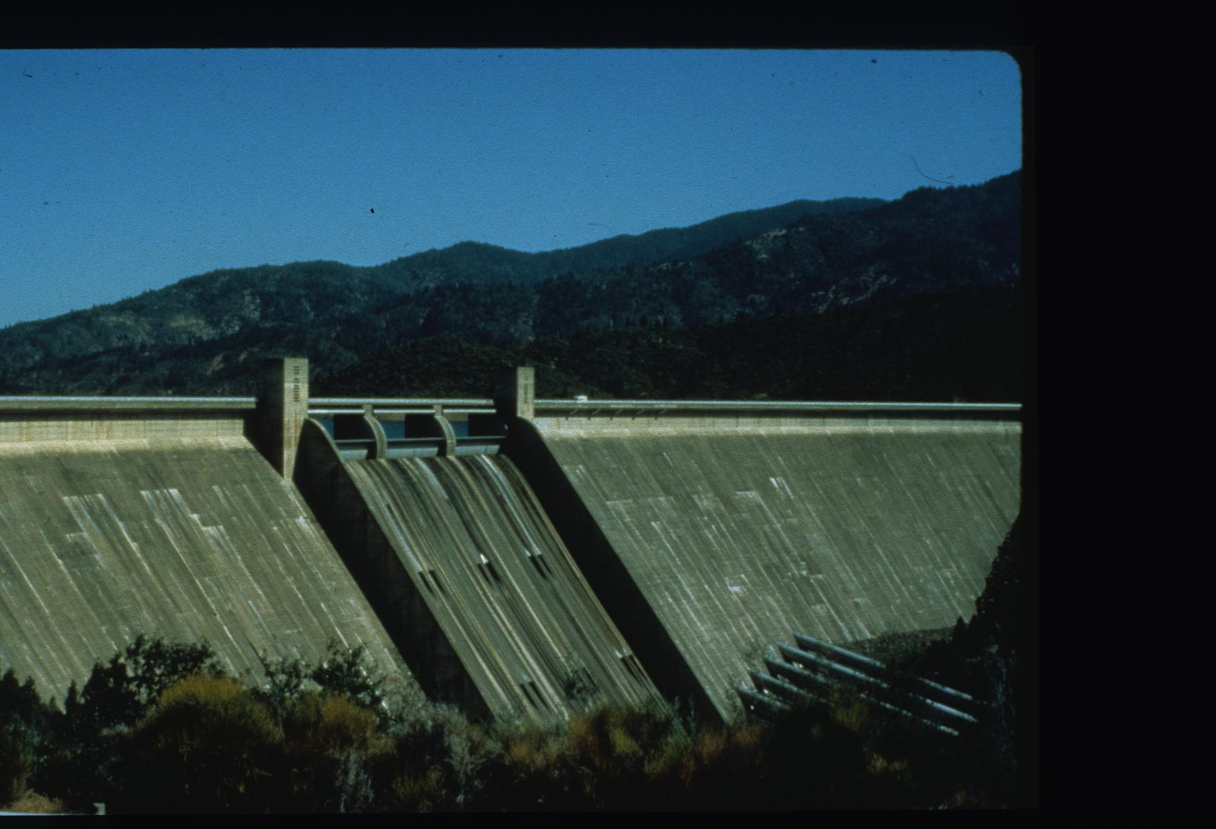
Hydropower Practice Problems - Part 1
Shasta Dam, Sacramento River, Northern California

Slide 17
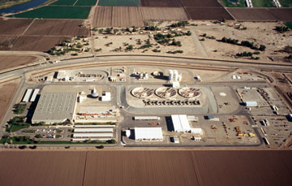
Energy is needed to improve water quality
Yuma Desalting Plant

Slide 18


Energy is needed to improve water quality
Just add tea!

Slide 19

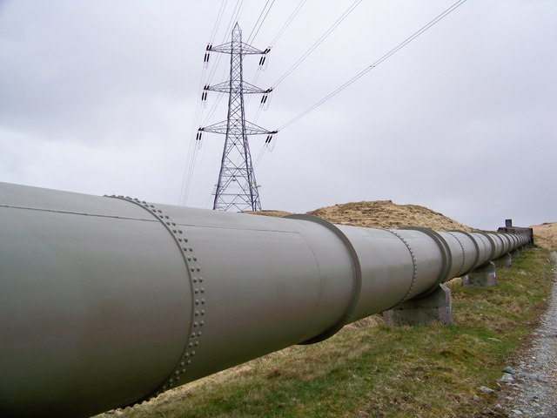
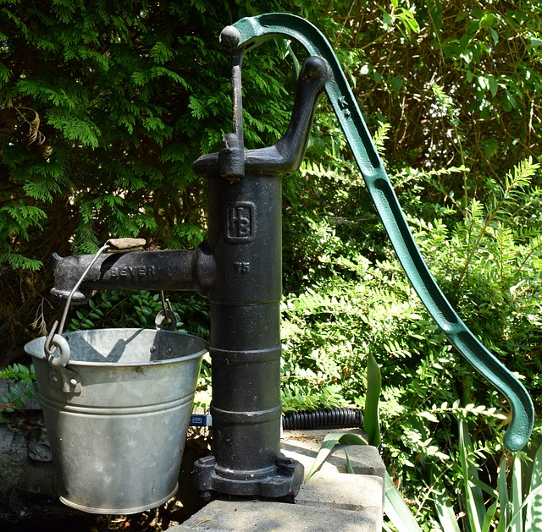

Energy is needed to move water where it is needed

Slide 20
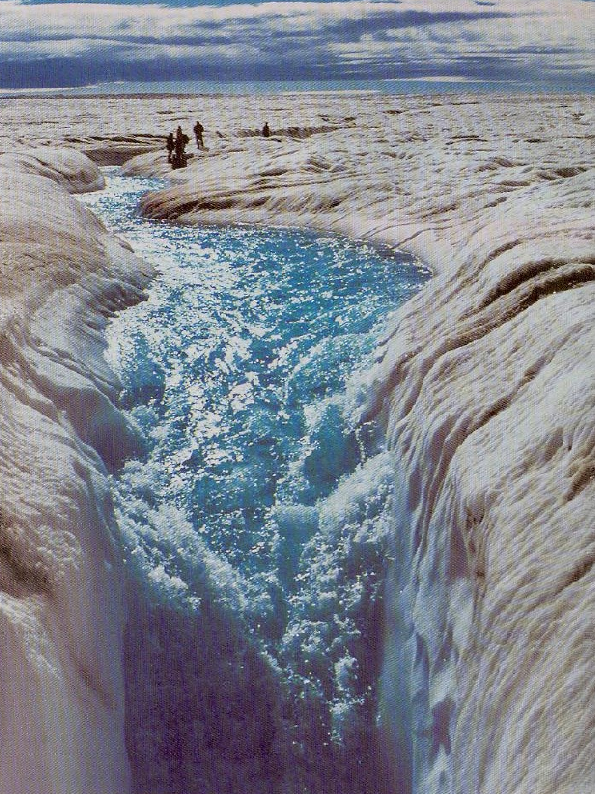
Environmental: Global warming affects water supply
Greenland Ice Sheet
Melt area has increased by 20%, 1979 - 2005
Total Greenland ice ~ 23 ft of sea level rise
At [CO₂] of 500 - 700 ppm ice sheet disintegration likely becomes irreversible
([CO₂] ₂₀₁₂ = 395 ppm)
An example of positive feedback
Source: Business Week Aug. 2004

Slide 21
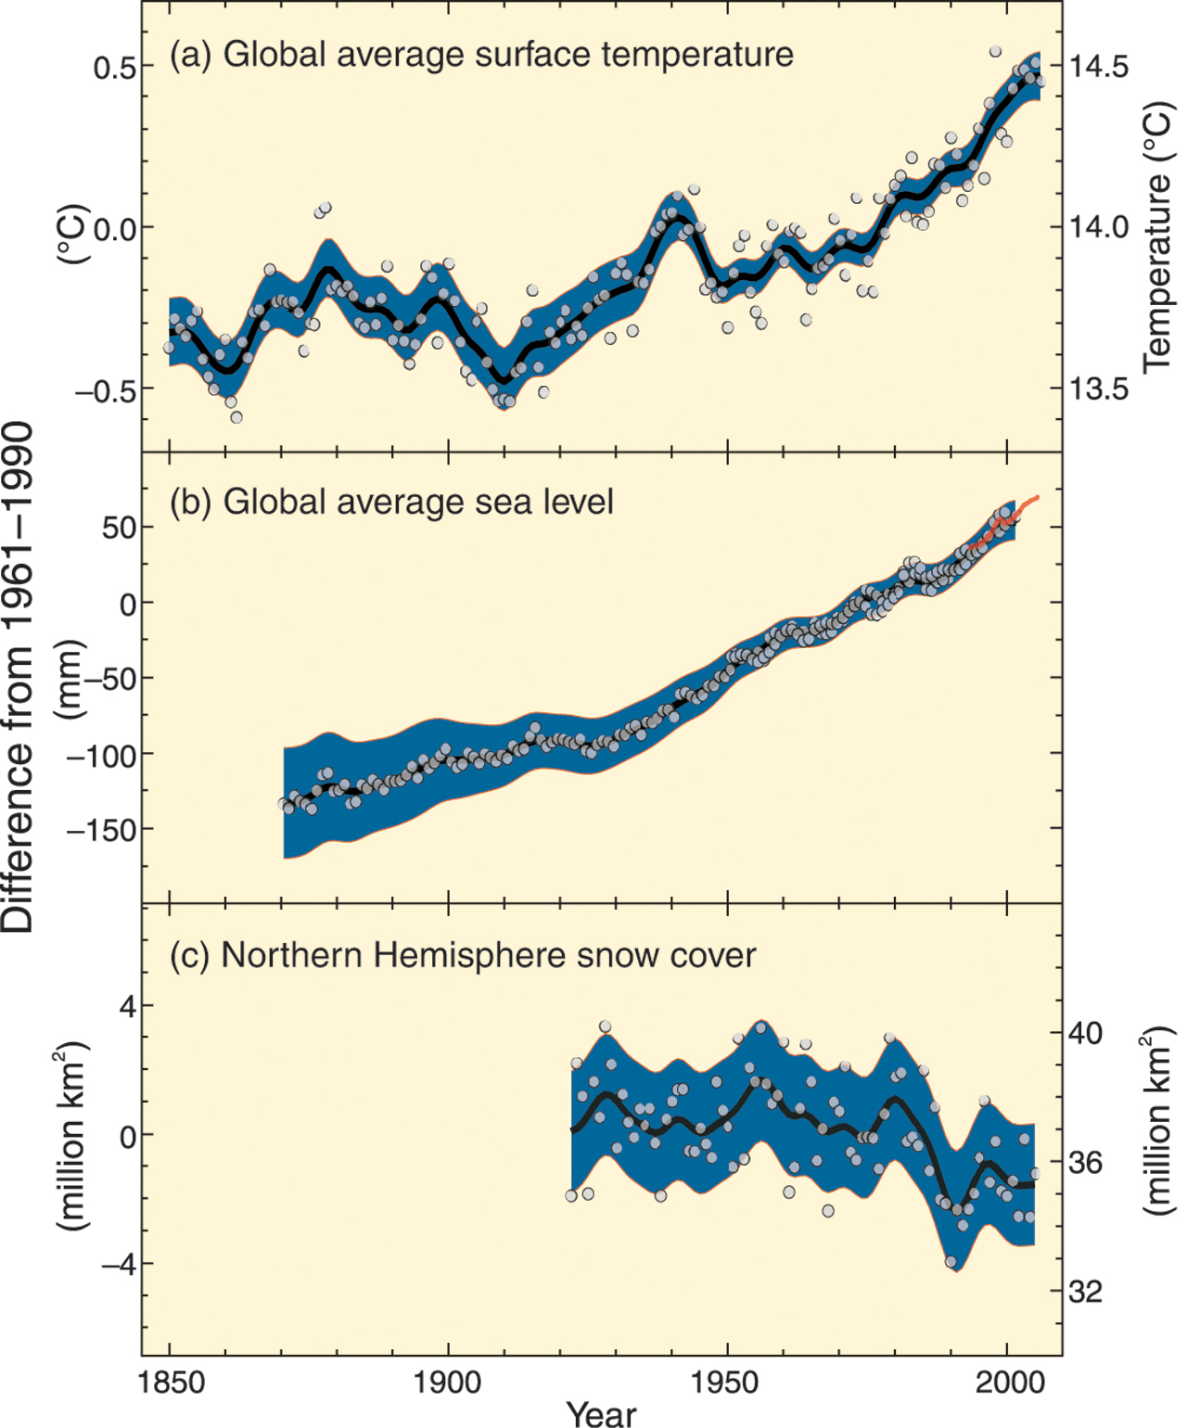
1st IPCC Assessment (1990): FAR: unequivocal detection of
human impact not likely
for a decade
FAR
2nd (1995) SAR: balance of evidence suggests discernible human influence
SAR
3rd (2001) TAR: most of the warming in the last 50 years is likely (>66%) due to human activities
TAR
AR4
4th (2007) AR4: most of the warming very likely (> 90%) due human activity
4th (2007): warming will most strongly and quickly impact the global poor
SRREN (2011): 80% clean by 2050 possible, if …

Slide 22
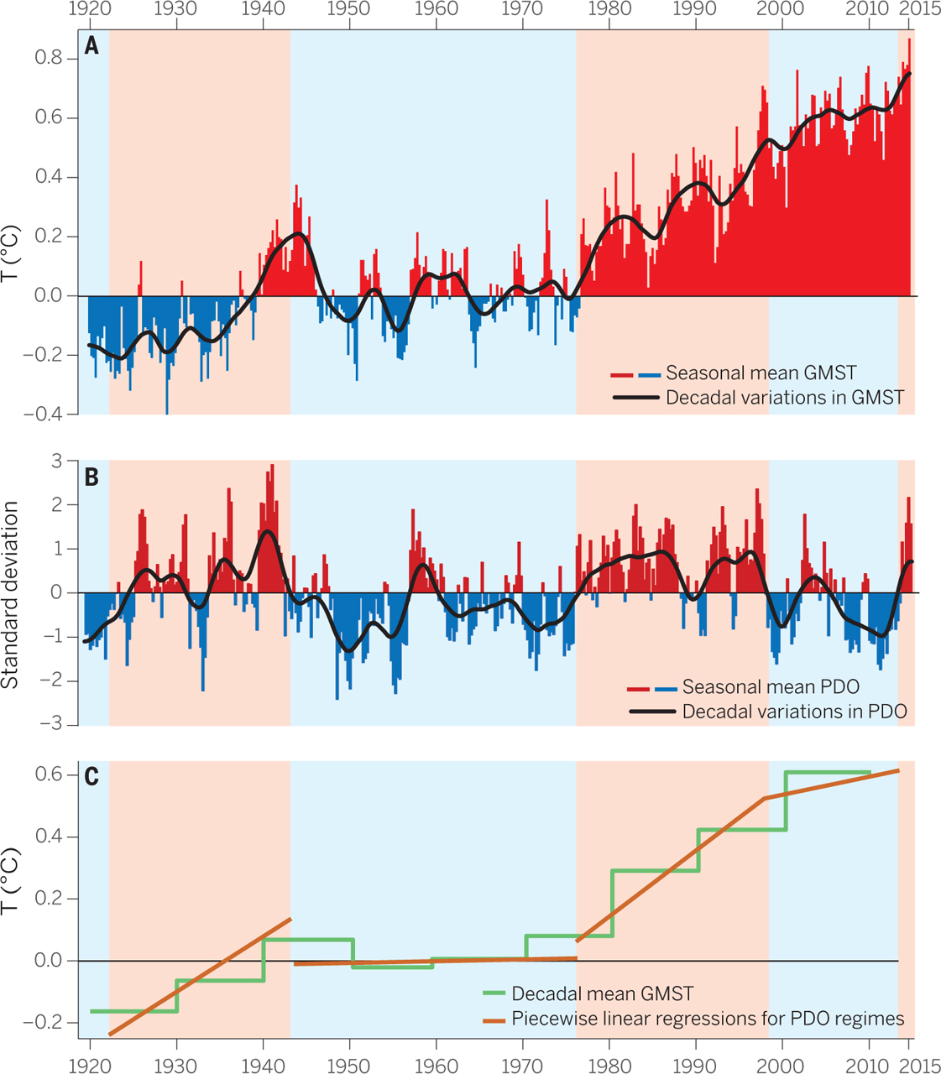
A staircase of rising temperatures
Kevin E. Trenberth Science 2015;349:691-692
Notes:
A staircase of rising temperatures. (A) Seasonal (December-January-February; etc.) global mean surface temperatures since 1920 (relative to the 20th-century mean) vary considerably on interannual and decadal time scales. Data from (19). (B) Seasonal mean PDO anomalies (8) show decadal regimes (positive in pink; negative in blue) as well as short-term variability. A 20-term Gaussian filter is used in both to show decadal variations, with anomalies reflected about the end point of March to May 2015 (heavy black curves). (C) Decadal average anomalies (starting 1921 to 1930) of GMST (green) along with piecewise slopes of GMST for the phases of the PDO (orange). Note how the rise in GMST (A) coincides with the positive (pink) phase (B) of the PDO at the rate given in (C).

Slide 23
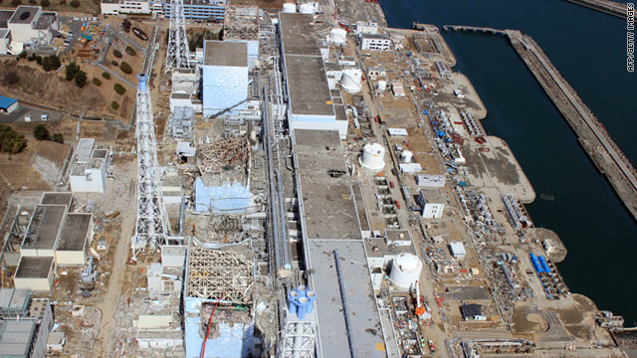
Fukishima Nuclear Disaster
disrupted water supply
For an inventory of effects, see:
Climatehotmap.org

Slide 24
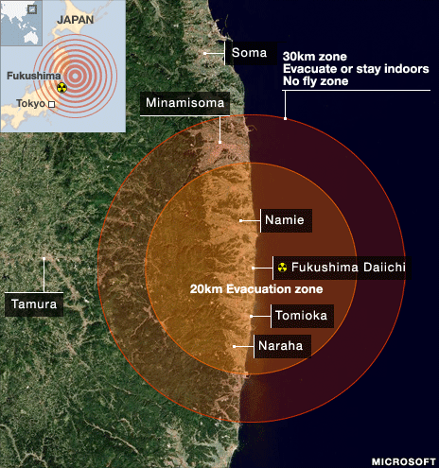
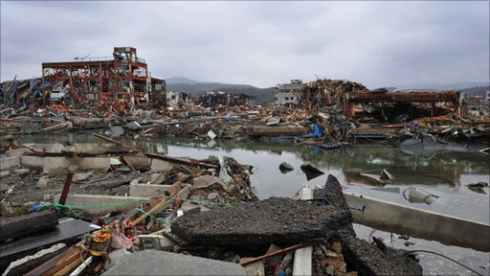
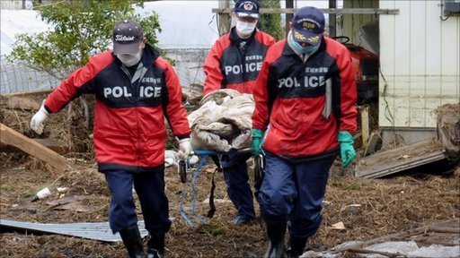
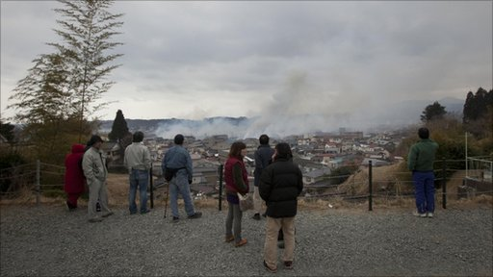
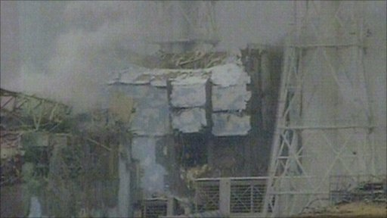
For an inventory of effects, see:
Climatehotmap.org

Slide 25
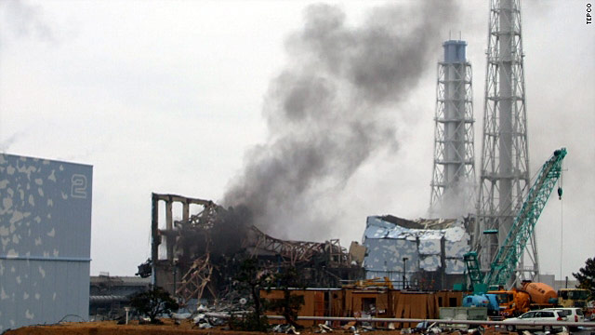
For an inventory of effects, see:
Climatehotmap.org

Slide 26
In TIM 155…
We will study water and energy independently as well as how they interact with each other.

Slide 27
Acknowledge….
Professor Dan Kammen and the course ER 100: Energy and Society, which Prof. Haddad TA’d in the mid-1990s!

